Slide 1
Adaboost
Lee-Ad Gottlieb

Slide 2
Adaboost
Suppose we have many weak learners
Their error is better than .5
but maybe not much better
Example: Spam detection
Contains “buy now” in title
Contains “medz” in title
Contains link in body
Contains prices in body

Slide 3
Adaboost
Suppose we have many weak learners
Their error is better than .5
but maybe not much better
Example: betting on horses
Win streak
Winning percentage
Pedigree

Slide 4

Adaboost
Can we join together weak rules to derive a stronger rule?
Approach:
Give each rule a weight of importance
Take a weighted vote
A
B
C
(A $∪$ B) $∩$ C
+
+
-
+
+
-
+
+
-
+
+
-
+
+
+
+
+
-
+
-
+
-
+
-
-
-
-
-
+
-
-
+
-
-
+
-
-
+
-
-

Slide 5
Adaboost
How many weak learners should we choose?
Bias-variance tradeoff
Bias: Empirical error on sample
Variance: Complexity of solution (VC-dimension)
Overfitting:
Low empirical error but high VC-dimension
Bad on world (true error)

Slide 6
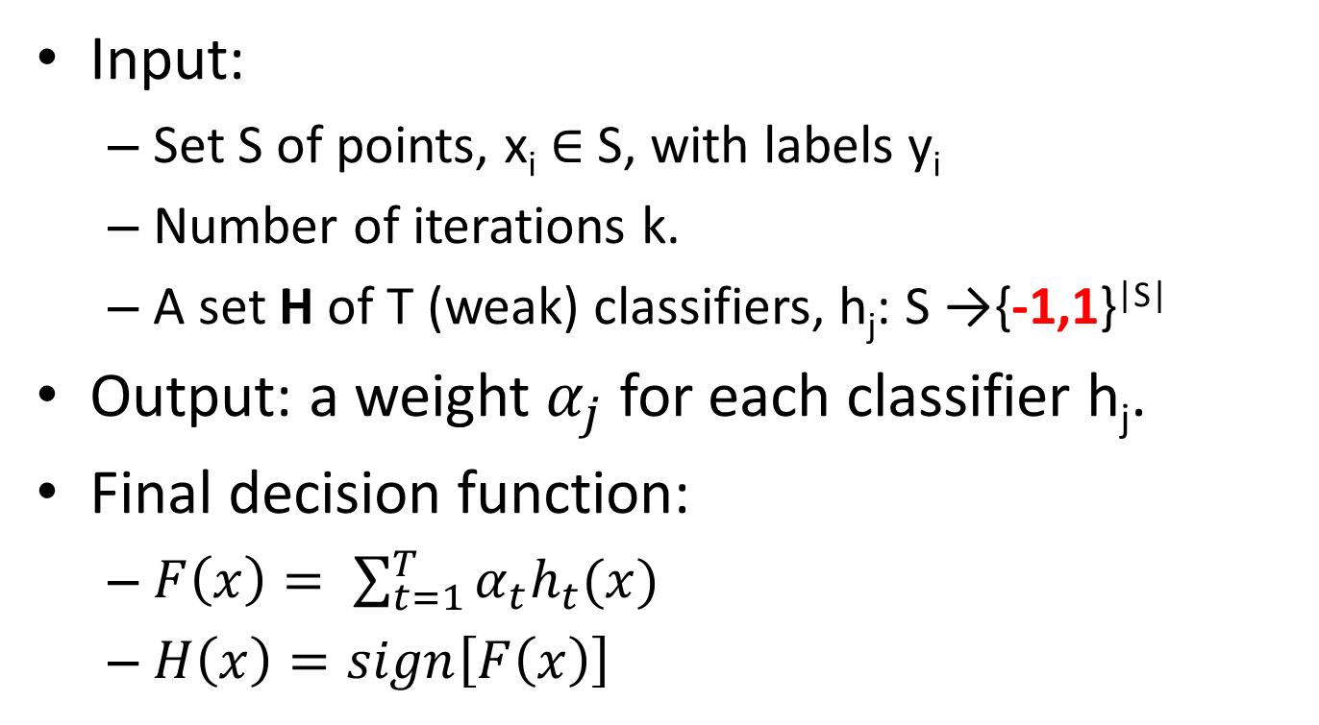
Adaboost
Input:
Set S of points, x_{i} $∈$ S, with labels y_{i}
Number of iterations k.
A set H of T (weak) classifiers, h_{j}: S →{-1,1}^{|S|}
Output: a weight $α_{j}$ for each classifier h_{j}.
Final decision function:
$F\left(x\right)= \sum_{t=1}^{T}{α_{t}h_{t}(x)}$
$H\left(x\right)=sign\left[F\left(x\right)\right]$

Slide 7
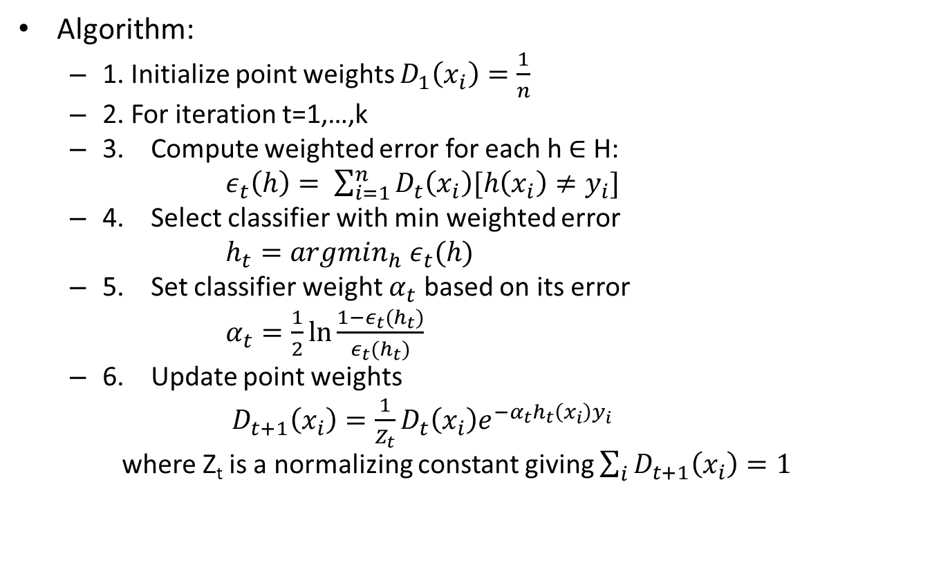
Adaboost
Algorithm:
1. Initialize point weights $D_{1}\left(x_{i}\right)=\frac{1}{n}$
2. For iteration t=1,…,k
3. Compute weighted error for each h $∈$ H:
$ε_{t}\left(h\right)= \sum_{i=1}^{n}{D_{t}\left(x_{i}\right)[h\left(x_{i}\right)≠y_{i}]}$
4. Select classifier with min weighted error
$h_{t}=argmin_{h}{ ε}_{t}(h)$
5. Set classifier weight $α_{t}$ based on its error
$α_{t}=\frac{1}{2}\ln{\frac{1−ε_{t}(h_{t})}{ε_{t}(h_{t})}}$
6. Update point weights
$D_{t+1}\left(x_{i}\right)=\frac{1}{Z_{t}}D_{t}\left(x_{i}\right)e_{}^{−α_{t}h_{t}\left(x_{i}\right)y_{i}}$
where Z_{t} is a normalizing constant giving $\sum_{i}{D_{t+1}\left(x_{i}\right)=1}$

Slide 8
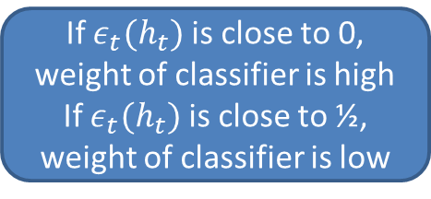
Adaboost
Algorithm:
1. Initialize point weights $D_{1}\left(x_{i}\right)=\frac{1}{n}$
2. For iteration t=1,…,k
3. Compute weighted error for each h $∈$ H:
$ε_{t}\left(h\right)= \sum_{i=1}^{n}{D_{t}\left(x_{i}\right)[h\left(x_{i}\right)≠y_{i}]}$
4. Select classifier with min weighted error
$h_{t}=argmin_{h}{ ε}_{t}(h)$
5. Set classifier weight $α_{t}$ based on its error
$α_{t}=\frac{1}{2}\ln{\frac{1−ε_{t}(h_{t})}{ε_{t}(h_{t})}}$
6. Update point weights
$D_{t+1}\left(x_{i}\right)=\frac{1}{Z_{t}}D_{t}\left(x_{i}\right)e_{}^{−α_{t}h_{t}\left(x_{i}\right)y_{i}}$
where Z_{t} is a normalizing constant giving $\sum_{i}{D_{t+1}\left(x_{i}\right)=1}$
If $ε_{t}(h_{t})$ is close to 0,
weight of classifier is high
If $ε_{t}(h_{t})$ is close to ½,
weight of classifier is low

Slide 9

Adaboost
Algorithm:
1. Initialize point weights $D_{1}\left(x_{i}\right)=\frac{1}{n}$
2. For iteration t=1,…,k
3. Compute weighted error for each h $∈$ H:
$ε_{t}\left(h\right)= \sum_{i=1}^{n}{D_{t}\left(x_{i}\right)[h\left(x_{i}\right)≠y_{i}]}$
4. Select classifier with min weighted error
$h_{t}=argmin_{h}{ ε}_{t}(h)$
5. Set classifier weight $α_{t}$ based on its error
$α_{t}=\frac{1}{2}\ln{\frac{1−ε_{t}(h_{t})}{ε_{t}(h_{t})}}$
6. Update point weights
$D_{t+1}\left(x_{i}\right)=\frac{1}{Z_{t}}D_{t}\left(x_{i}\right)e_{}^{−α_{t}h_{t}\left(x_{i}\right)y_{i}}$
where Z_{t} is a normalizing constant giving $\sum_{i}{D_{t+1}\left(x_{i}\right)=1}$
If $h_{t}\left(x_{i}\right)=y_{i}$, then $h_{t}\left(x_{i}\right)y_{i}=1$, and point weight decreases
If $h_{t}\left(x_{i}\right)≠y_{i}$, then $h_{t}\left(x_{i}\right)y_{i}=−1$, and point weight increases

Slide 10
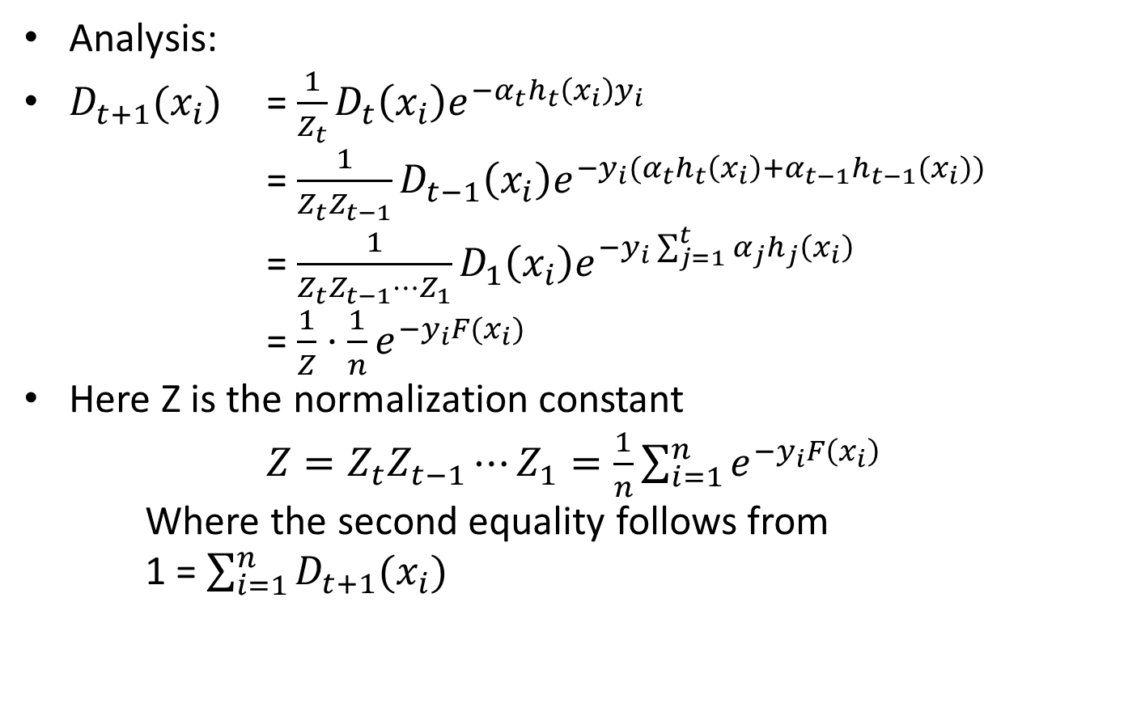
Adaboost
Analysis:
$D_{t+1}(x_{i})$ = $\frac{1}{Z_{t}}D_{t}\left(x_{i}\right)e^{−α_{t}h_{t}\left(x_{i}\right)y_{i}}$
= $\frac{1}{Z_{t}Z_{t−1}}D_{t−1}\left(x_{i}\right)e^{−{y_{i}(α}_{t}h_{t}\left(x_{i}\right)+α_{t−1}h_{t−1}(x_{i}))}$
= $\frac{1}{Z_{t}Z_{t−1}⋯Z_{1}}D_{1}\left(x_{i}\right)e^{−y_{i}\sum_{j=1}^{t}{α_{j}h_{j}\left(x_{i}\right)}}$
= $\frac{1}{Z}⋅\frac{1}{n}e^{−y_{i}F(x_{i})}$
Here Z is the normalization constant
$Z=Z_{t}Z_{t−1}⋯Z_{1}=\frac{1}{n}\sum_{i=1}^{n}{e^{{−y}_{i}F\left(x_{i}\right)}}$
Where the second equality follows from
1 =$\sum_{i=1}^{n}{D_{t+1}(x_{i})}$

Slide 11
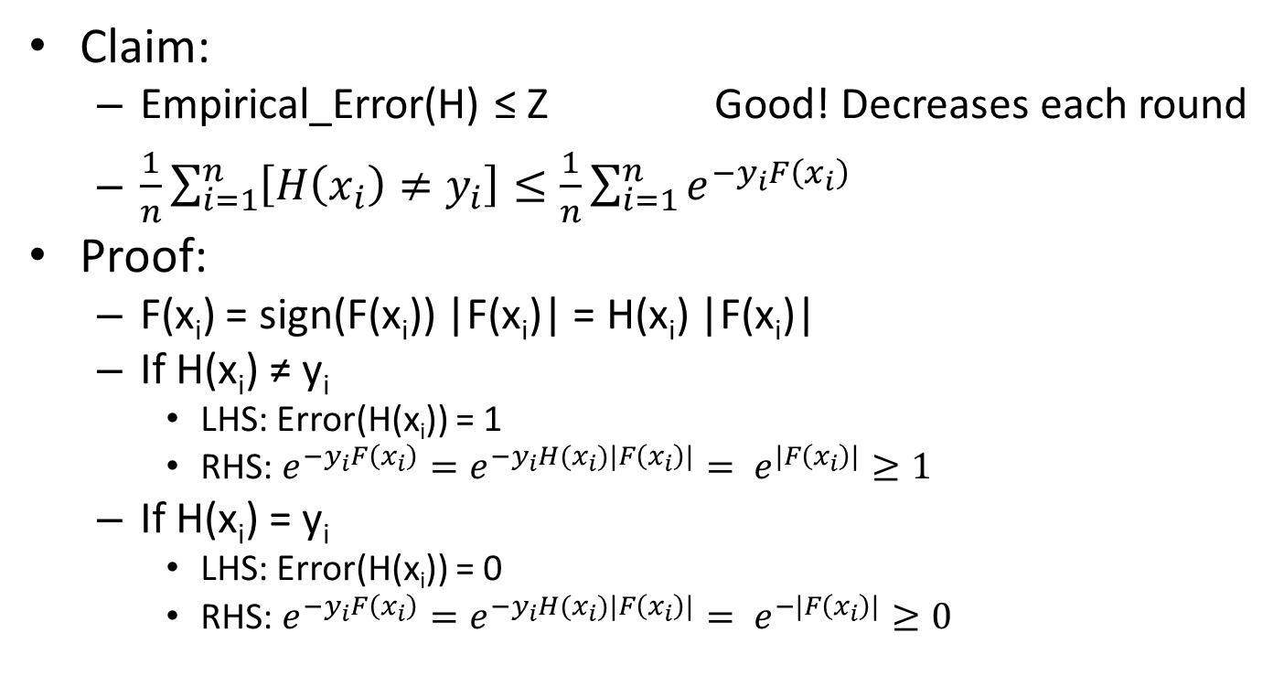
Adaboost
Claim:
Empirical_Error(H) ≤ Z Good! Decreases each round
$\frac{1}{n}\sum_{i=1}^{n}{\left[H\left(x_{i}\right)≠y_{i}\right]≤\frac{1}{n}\sum_{i=1}^{n}{e^{−y_{i}F\left(x_{i}\right)}}}$
Proof:
F(x_{i}) = sign(F(x_{i})) |F(x_{i})| = H(x_{i}) |F(x_{i})|
If H(x_{i}) ≠ y_{i}
LHS: Error(H(x_{i})) = 1
RHS: $e^{−y_{i}F\left(x_{i}\right)}=e^{−y_{i}H(x_{i})|F\left(x_{i}\right)|}= e^{|F\left(x_{i}\right)|}≥1$
If H(x_{i}) = y_{i}
LHS: Error(H(x_{i})) = 0
RHS: $e^{−y_{i}F\left(x_{i}\right)}=e^{−y_{i}H(x_{i})|F\left(x_{i}\right)|}= e^{−|F\left(x_{i}\right)|}≥0$

Slide 12
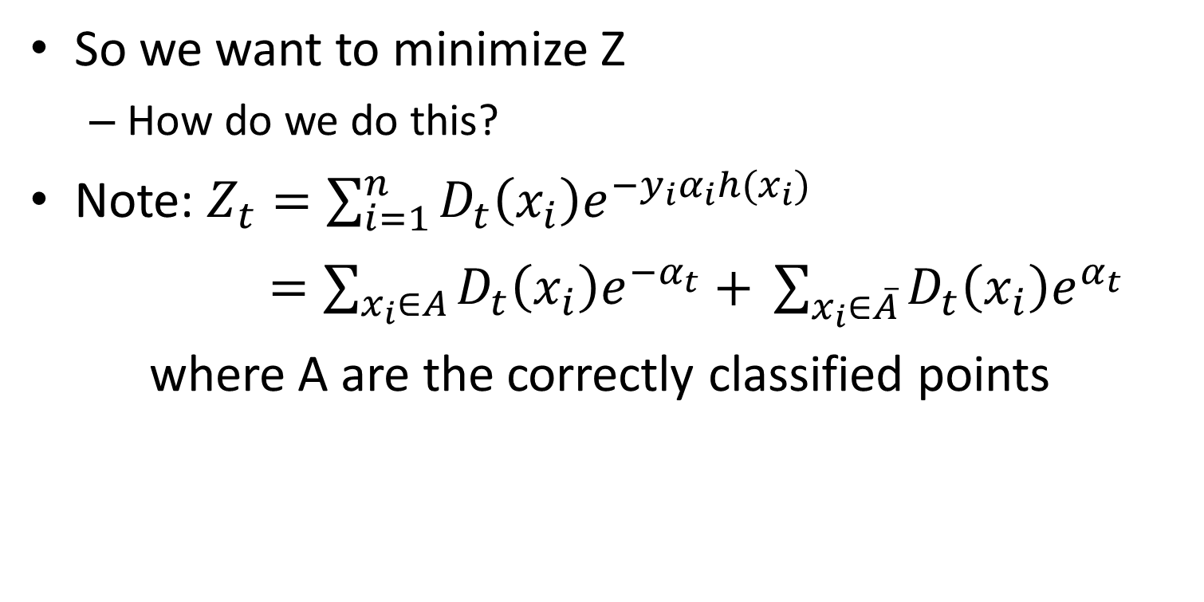
Adaboost
So we want to minimize Z
How do we do this?
Note: $Z_{t}={\sum_{i=1}^{n}{D_{t}\left(x_{i}\right)e^{−y_{i}α_{i}h(x_{i})}}}_{}$
$=\sum_{x_{i}∈A}{D_{t}\left(x_{i}\right)e^{−α_{t}}+ }\sum_{x_{i}∈\overline{A}}{D_{t}\left(x_{i}\right)e^{α_{t}} }$
where A are the correctly classified points

Slide 13

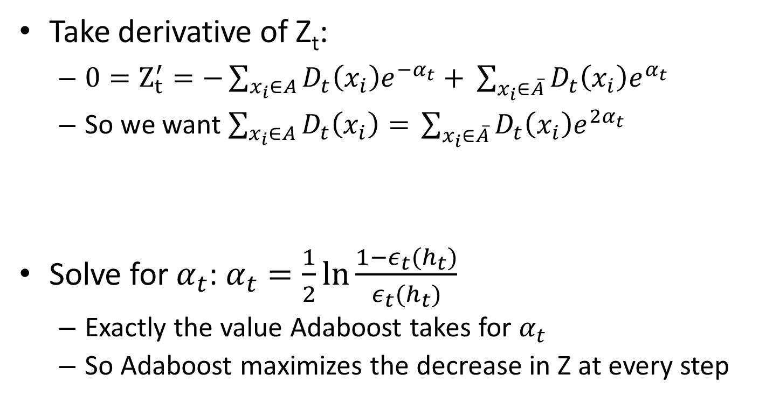

Adaboost
Take derivative of Z_{t}:
$0=Z_{t}^{′}=−\sum_{x_{i}∈A}{D_{t}\left(x_{i}\right)e^{−α_{t}}+ }\sum_{x_{i}∈\overline{A}}{D_{t}\left(x_{i}\right)e^{α_{t}} }$
So we want $\sum_{x_{i}∈A}{D_{t}\left(x_{i}\right)= }\sum_{x_{i}∈\overline{A}}{D_{t}\left(x_{i}\right)e^{2α_{t}} }$
Solve for $α_{t}$: $α_{t}=\frac{1}{2}\ln{\frac{1−ε_{t}(h_{t})}{ε_{t}(h_{t})}}$
Exactly the value Adaboost takes for $α_{t}$
So Adaboost maximizes the decrease in Z at every step
$$1−ε_{t}(h_{t})$$
$$ε_{t}(h_{t})$$

Slide 14
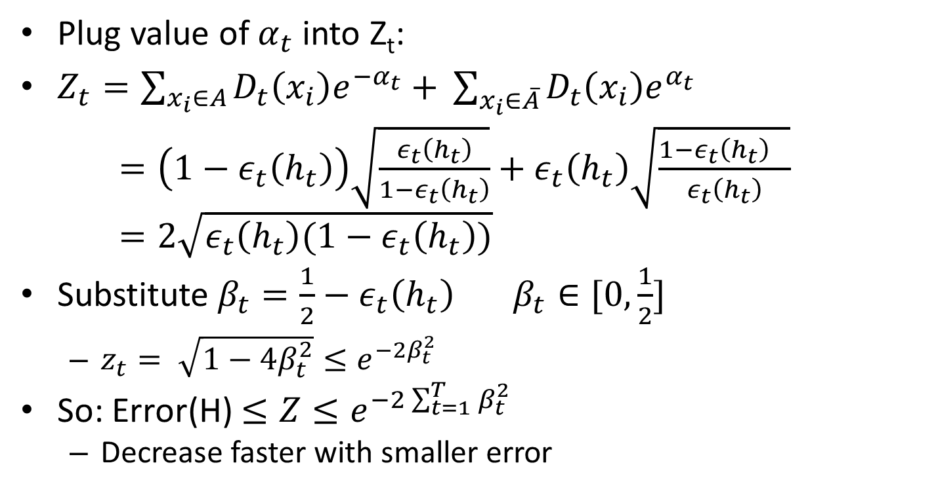
Adaboost
Plug value of $α_{t}$into Z_{t}:
$Z_{t}=\sum_{x_{i}∈A}{D_{t}\left(x_{i}\right)e^{−α_{t}}+ }\sum_{x_{i}∈\overline{A}}{D_{t}\left(x_{i}\right)e^{α_{t}} }$
$=\left(1−ε_{t}\left(h_{t}\right)\right)\sqrt{\frac{ε_{t}\left(h_{t}\right)}{1−ε_{t}\left(h_{t}\right)}}+ε_{t}\left(h_{t}\right)\sqrt{\frac{{1−ε_{t}\left(h_{t}\right)}_{}}{ε_{t}\left(h_{t}\right)}}$
$=2\sqrt{ε_{t}\left(h_{t}\right)(1−ε_{t}\left(h_{t}\right))}$
Substitute $β_{t}=\frac{1}{2}−ε_{t}\left(h_{t}\right)$ $β_{t}∈[0,\frac{1}{2}]$
$z_{t}= \sqrt{1−4β_{t}^{2}}≤e^{−2β_{t}^{2}}$
So: Error(H) $≤Z≤e^{−2\sum_{t=1}^{T}{β_{t}^{2}}}$
Decrease faster with smaller error

